Slide 1
End-to-End Machine Learning Product for Telecom
Customer Churn Prediction
Naveen Kumar Sivakumar

Slide 2
Problem Statement:
As a Data Scientist in a telecom company, I developed an end-to-end machine learning solution to predict customer churn using historical data such as demographics, account details, subscribed services, and billing information. The model not only identifies customers at risk of leaving but also explains the key factors driving churn, enabling the business to take proactive retention actions and improve customer loyalty.
Business Use Cases:
The solution identifies customers at high risk of churn, enabling timely and targeted retention strategies. By leveraging data-driven insights, it helps reduce customer acquisition costs while improving overall customer lifetime value (CLV). Additionally, it supports personalized offers and empowers management to make informed, strategic decisions.

Slide 3
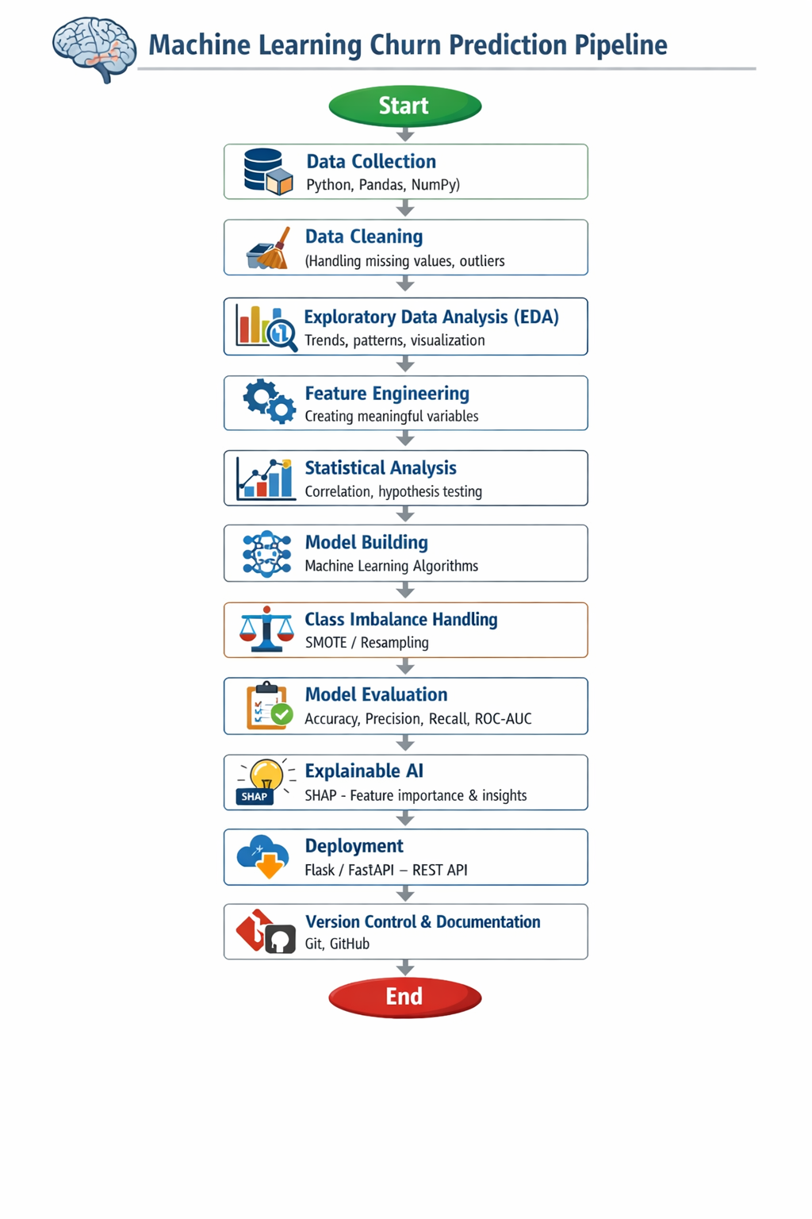

Slide 4
Data Understanding & Ingestion:
The first step in the project involves data understanding and ingestion, where the telecom customer churn dataset is loaded and explored in detail. This phase focuses on interpreting the business meaning of each column to ensure a clear understanding of customer behavior and service usage patterns. Key attributes include customer demographics such as gender, senior citizen status, partner, and dependents, along with account-related details like tenure, contract type, and payment method.
Additionally, the dataset captures service-related features such as phone service, internet service, online security, backup, device protection, tech support, and streaming services. Billing information, including monthly and total charges, provides insights into customer spending patterns. The target variable, churn, indicates whether a customer has left the service, forming the foundation for building predictive models and deriving actionable business insights.

Slide 5
Exploratory Data Analysis (EDA):
Exploratory Data Analysis (EDA) is a crucial step in the machine learning pipeline that involves analyzing and visualizing data to uncover patterns, trends, and relationships. It helps in understanding the underlying structure of the dataset, identifying anomalies, and generating insights that guide feature selection and model building. Through EDA, we aim to answer key business questions and validate assumptions using data-driven evidence.
In this project, a detailed analysis is performed to address important business questions such as whether senior citizens churn more, how tenure influences churn behavior, which contract types have the highest churn rates, and whether monthly billing impacts customer decisions. Additionally, the analysis explores which services are associated with higher churn, enabling better understanding of customer preferences and risks.
To support these insights, several visualizations are created, including churn distribution to identify class imbalance, tenure vs churn, monthly charges vs churn, contract type vs churn, internet service vs churn, and a correlation heatmap. These visual tools provide a comprehensive view of customer behavior and play a vital role in building effective predictive models.

Slide 6
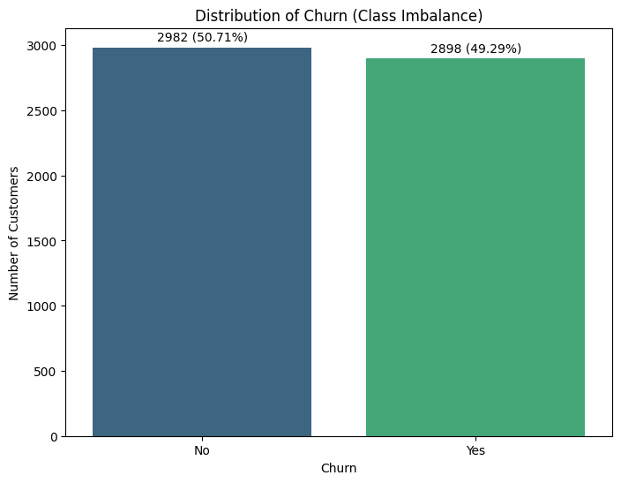
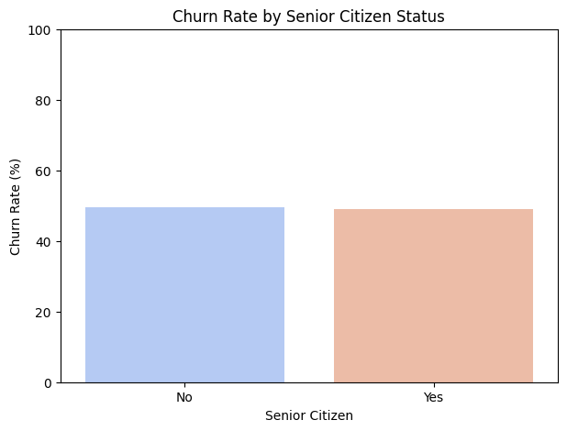
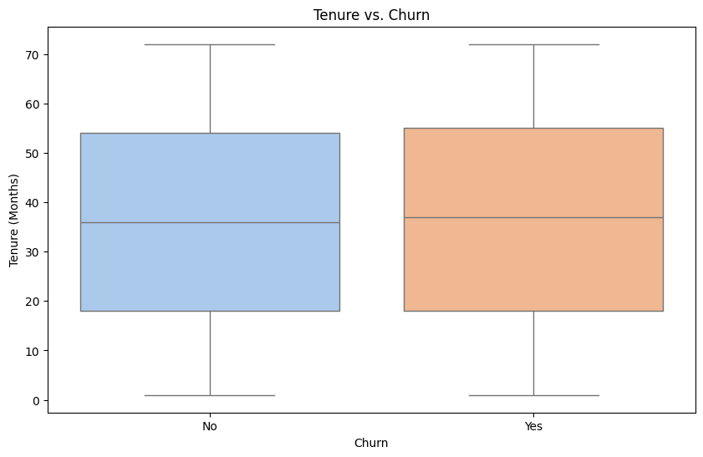
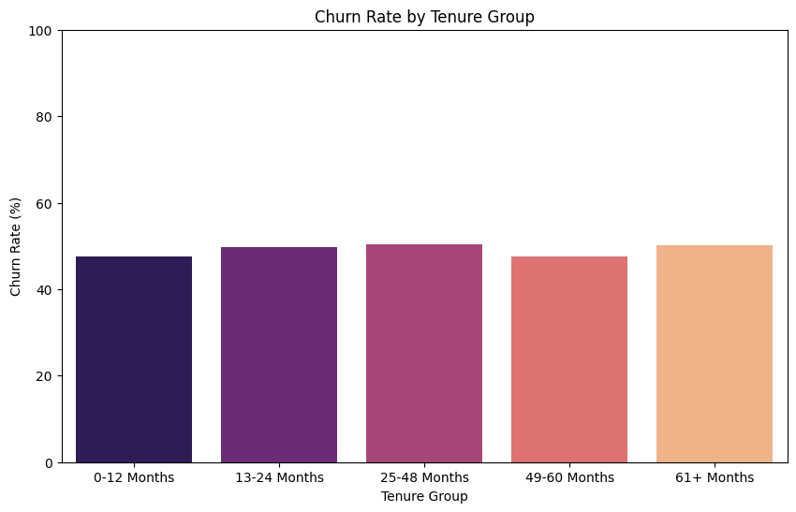

Slide 7
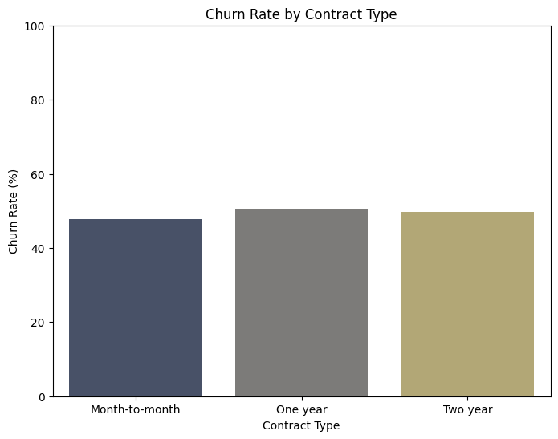
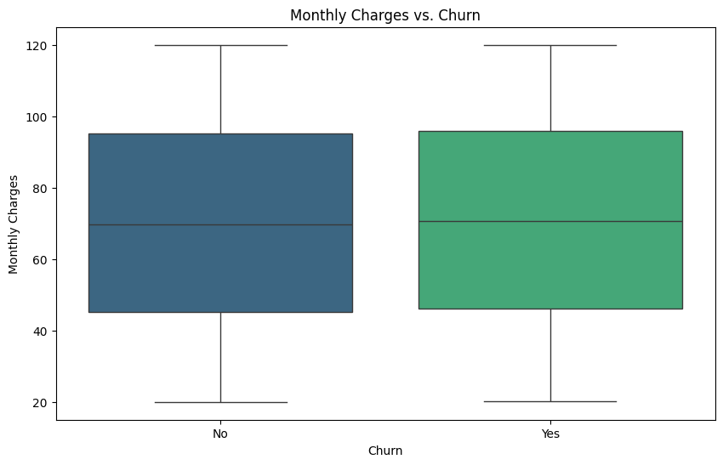
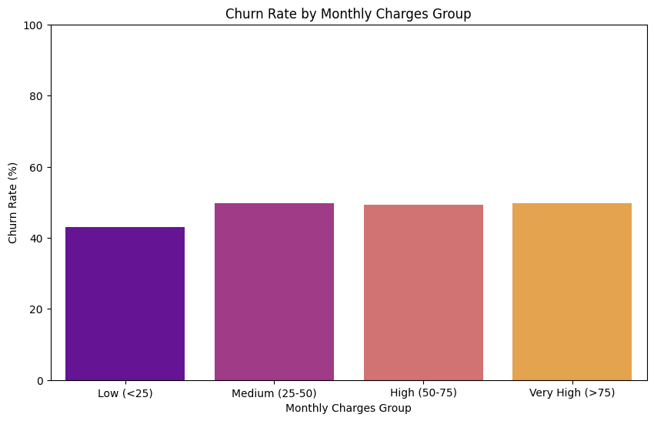

Slide 8
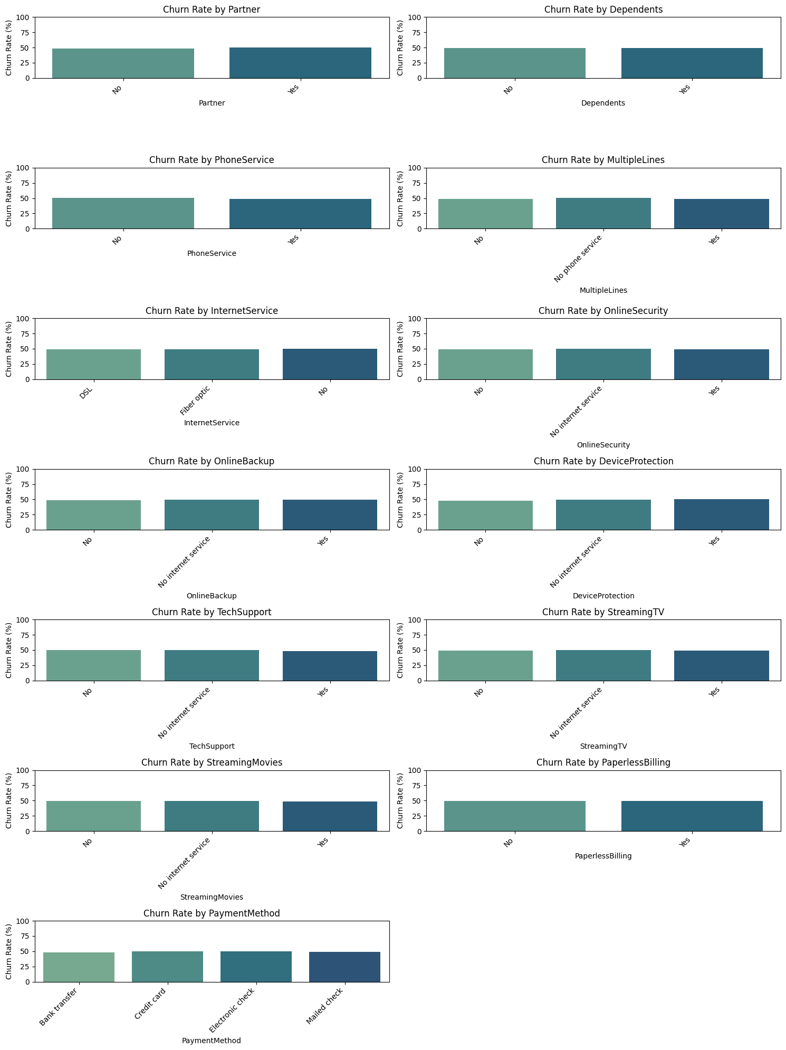

Slide 9
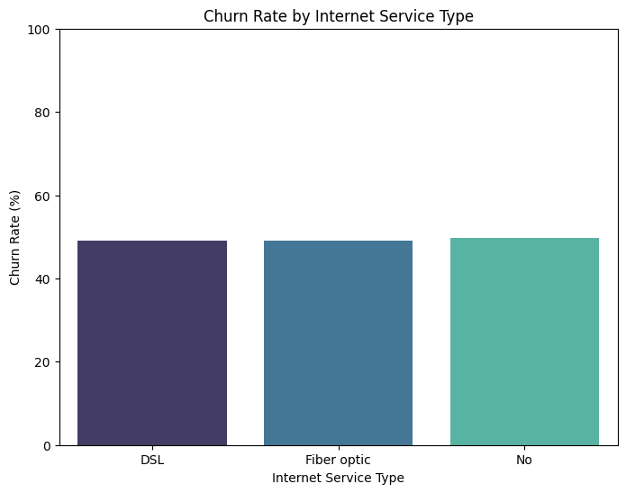

Slide 10
Feature Engineering:
Feature Engineering is a vital step in the machine learning process that focuses on transforming raw data into meaningful features that improve model performance and interpretability. It involves creating new variables, modifying existing ones, and incorporating domain knowledge to better capture customer behavior and business context.
In this project, several meaningful features are engineered to enhance churn prediction. For instance, AvgMonthlySpend is calculated as TotalCharges divided by tenure to understand spending patterns over time. Customers are segmented into tenure buckets such as New, Medium, and Loyal to capture lifecycle stages. A service count feature is created to represent the number of services subscribed by each customer, while contract duration flags help distinguish between short-term and long-term commitments. Additionally, a high-value customer indicator is introduced to identify customers contributing significantly to revenue. Each of these engineered features is designed with clear business relevance, enabling better insights and more effective decision-making.

Slide 11
Handling Class Imbalance:
Handling class imbalance is a critical step in building a reliable churn prediction model, especially when the number of churned customers is significantly lower than non-churned ones. If not addressed properly, the model may become biased toward the majority class and fail to correctly identify customers who are likely to churn. Therefore, techniques such as applying class weights or using resampling methods like oversampling (e.g., SMOTE) and undersampling are employed to balance the dataset and improve model learning.
In this project, special attention is given to evaluation metrics beyond simple accuracy, as accuracy alone can be misleading in imbalanced scenarios. Instead, metrics such as recall, precision, F1-score, and ROC-AUC are prioritized to ensure the model effectively identifies churn cases while maintaining overall performance. This approach enables the development of a more robust and business-relevant model that can accurately detect high-risk customers and support proactive retention strategie

Slide 12
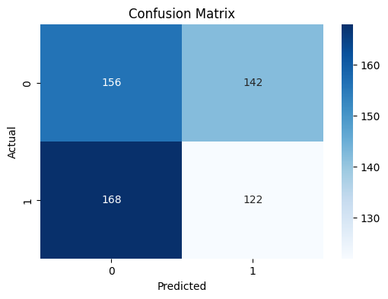
Random Forest :
Model Evaluation (Validation Set):
Precision: 0.4621
Recall: 0.4207
F1-Score: 0.4404
ROC-AUC: 0.4902
Classification Report:
precision recall f1-score support
0 0.48 0.52 0.50 298
1 0.46 0.42 0.44 290
accuracy 0.47 588
macro avg 0.47 0.47 0.47 588
weighted avg 0.47 0.47 0.47 588

Slide 13
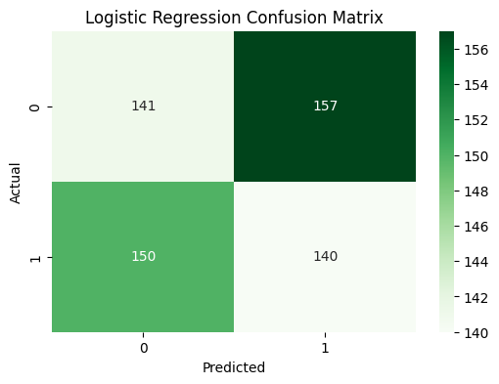
LogisticRegression:
Logistic Regression Baseline: Classification Report
precision recall f1-score support
0 0.48 0.47 0.48 298
1 0.47 0.48 0.48 290
accuracy 0.48 588
macro avg 0.48 0.48 0.48 588
weighted avg 0.48 0.48 0.48 588

Slide 14
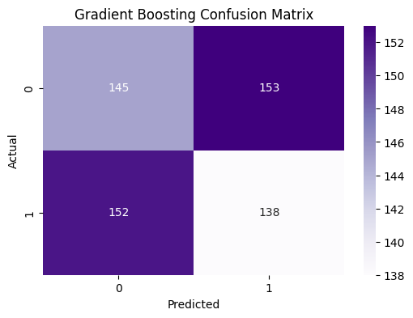
GradientBoostingClassifier:
-Gradient Boosting Classifier
precision recall f1-score support
0 0.49 0.49 0.49 298
1 0.47 0.48 0.48 290
accuracy 0.48 588
macro avg 0.48 0.48 0.48 588
weighted avg 0.48 0.48 0.48 588

Slide 15
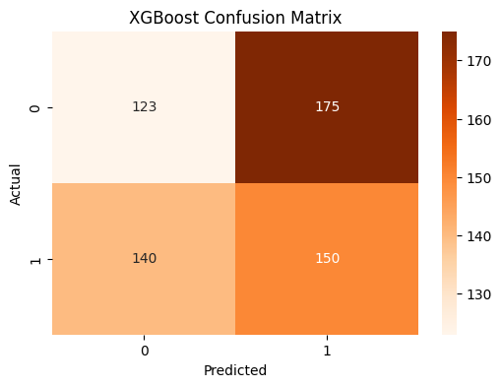
XGBoost:
XGBoost Classifier
precision recall f1-score support
0 0.47 0.41 0.44 298
1 0.46 0.52 0.49 290
accuracy 0.46 588
macro avg 0.46 0.46 0.46 588
weighted avg 0.46 0.46 0.46 588

Slide 16
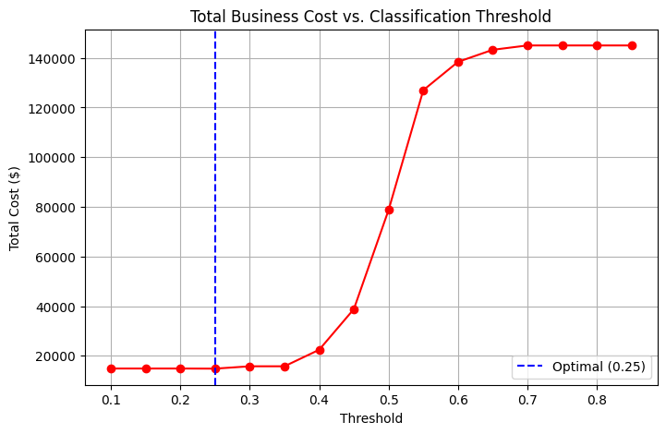
Threshold Optimization:
Threshold tuning allows control over the balance between identifying more potential churners and avoiding unnecessary retention efforts. For example, lowering the threshold can help capture more at-risk customers when churn is costly, while a higher threshold can reduce spending on incentives. This brief adjustment makes the model more practical, cost-effective, and aligned with real-world decision-making.

Slide 17
Model Explainability:
SHAP Global Feature Importance:
Identifies the overall impact of each feature on churn prediction across all customers
Highlights the most influential drivers of churn (e.g., contract type, tenure, monthly charges)
Helps understand general customer behavior patterns at a business level
Enables prioritization of key factors for strategic decision-making
Useful for communicating insights to stakeholders in a simplified manner
SHAP Local Explanations (Per Customer):
Explains individual predictions by showing how each feature contributes to a specific customer’s churn risk
Identifies personalized reasons for why a customer may churn
Helps customer support and marketing teams take targeted retention actions
Provides transparency and trust in model predictions
Useful for creating customized offers based on individual customer profiles

Slide 18
Streamlit dashboard:
The Streamlit application serves as an interactive front-end for the churn prediction model, allowing users to easily input customer details and receive real-time predictions. It provides a user-friendly interface to visualize churn probability along with key insights derived from the model.
Additionally, the app can display explainable AI outputs such as SHAP values, helping users understand the reasons behind each prediction. This enables business teams to make quick, data-driven decisions and take proactive actions to retain high-risk customers.

